Slide 1

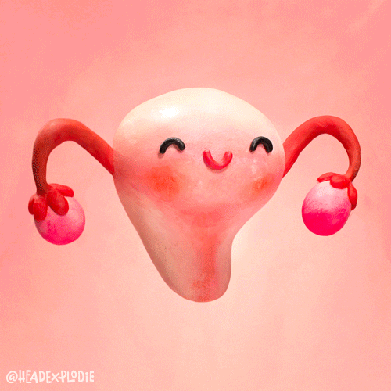
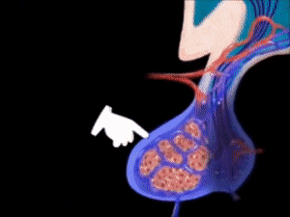
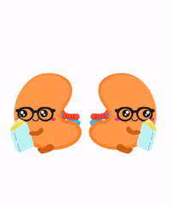
Endocrinology Pharmacology

Slide 2
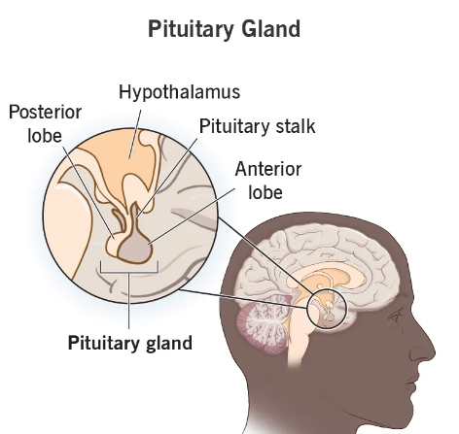
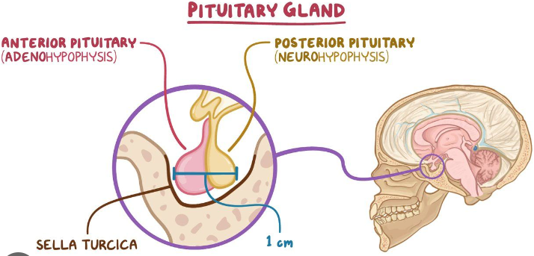

Slide 3
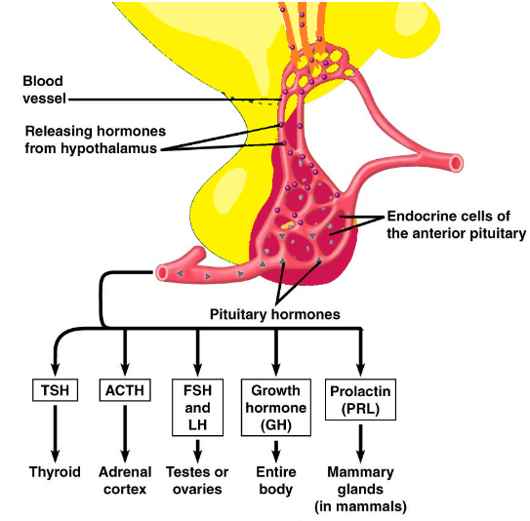
Hypothalamo-hypophyseal portal system

Slide 4
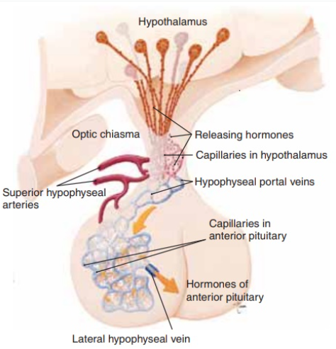

Slide 5
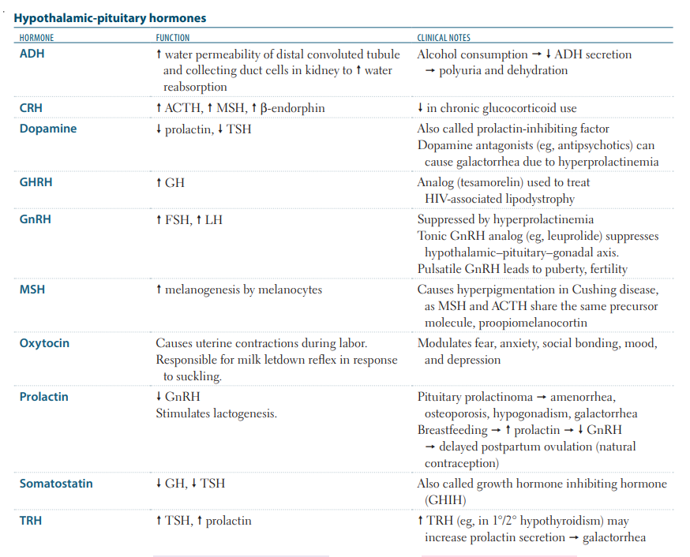

Slide 6
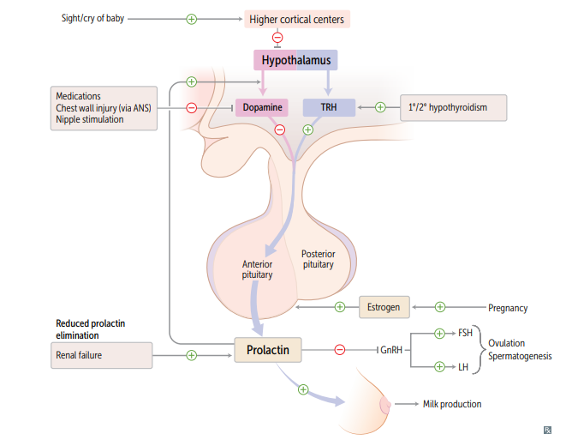
Treatment of Prolactinoma:
Dopamine agonists- Bromocriptine and cabergoline
Drugs that cause galactorrhea:
Dopamine antagonist- Metoclopramide

Slide 7
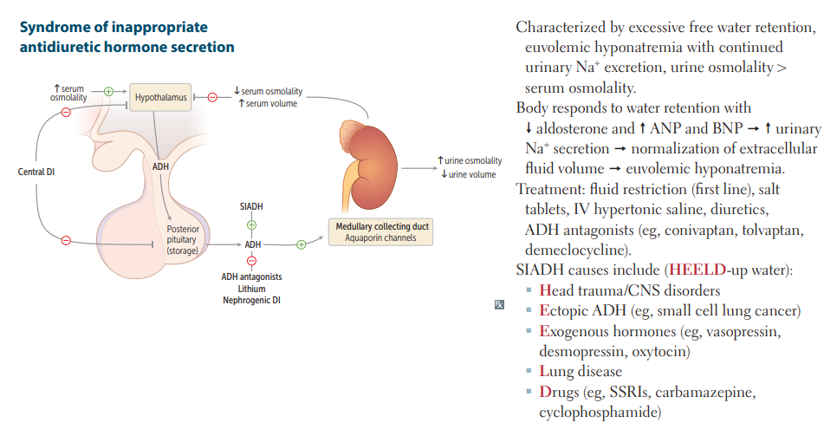

Slide 8
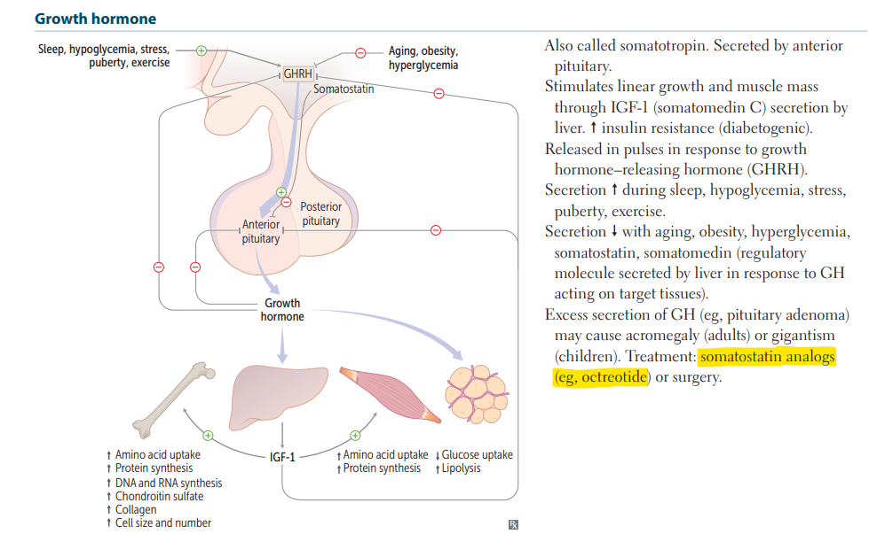

Slide 9


Slide 10
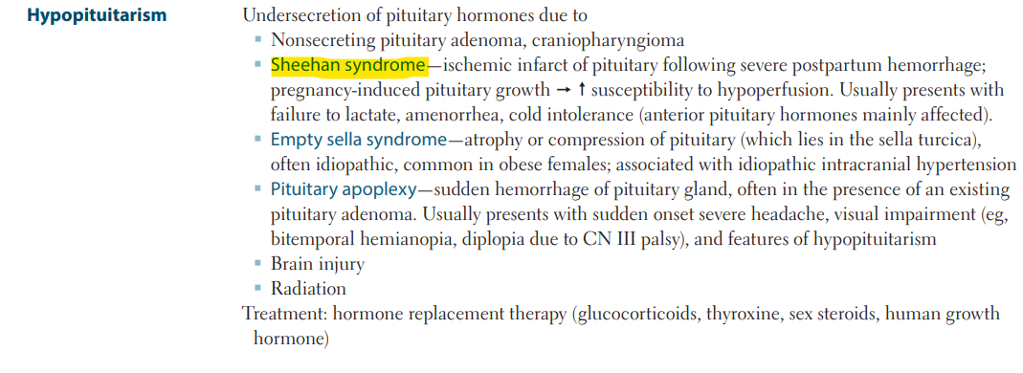

Slide 11
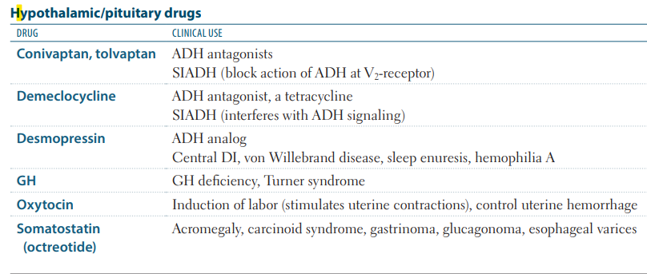

Slide 12
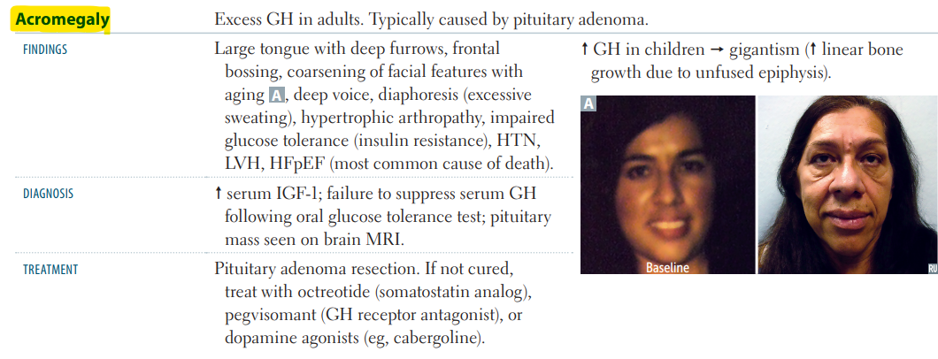

Slide 13
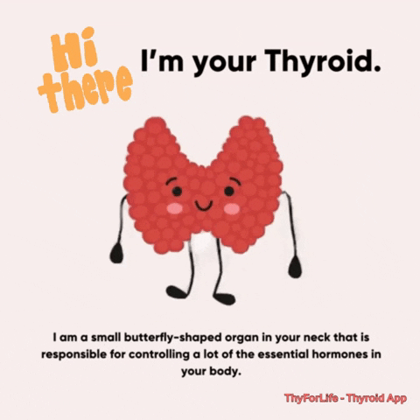

Slide 14
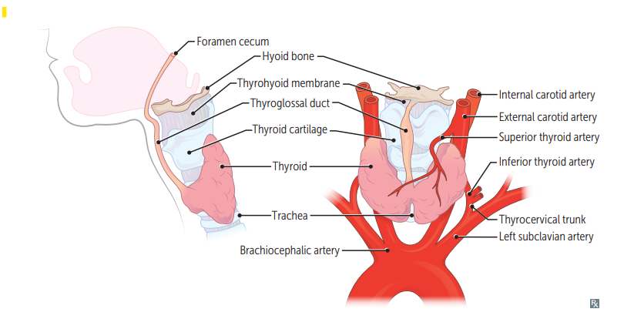

Slide 15
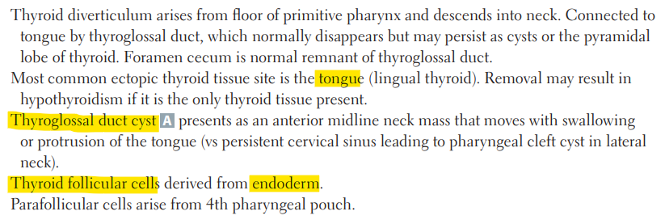

Slide 16
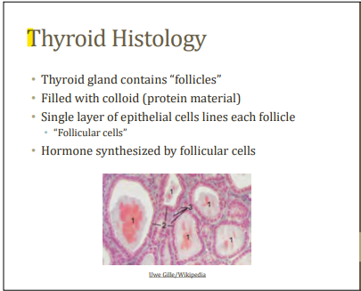

Slide 17
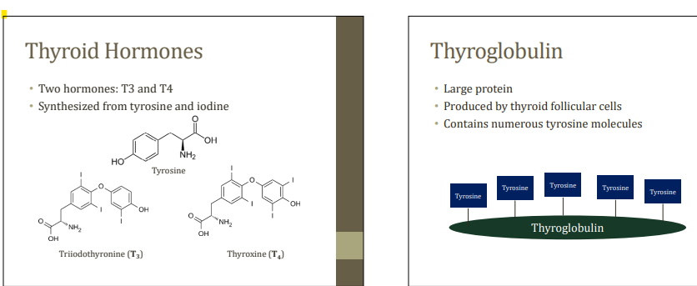

Slide 18
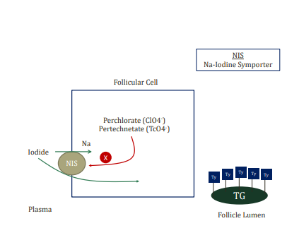
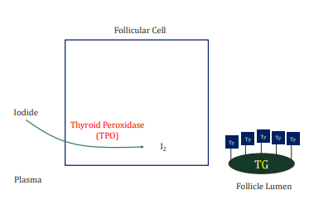
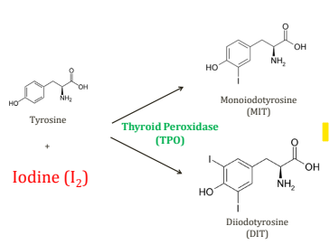
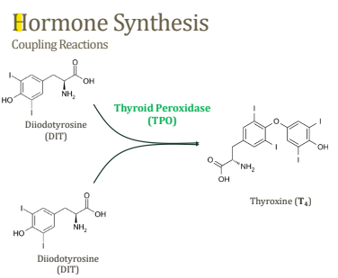

Slide 19
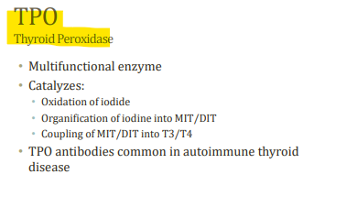
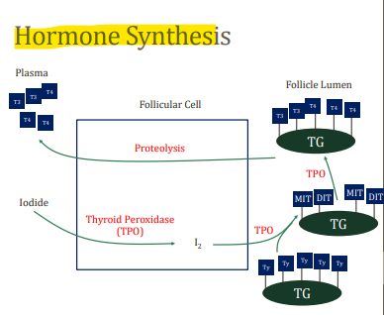
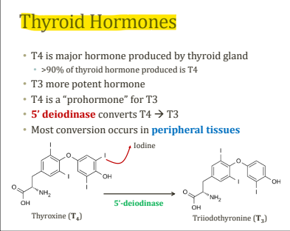
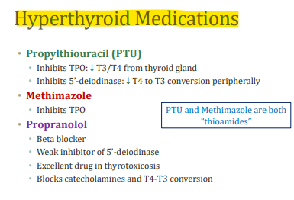

Slide 20


Slide 21
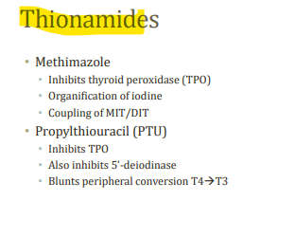
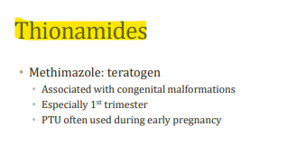
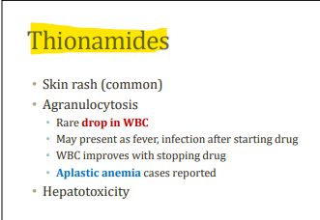
Aplastic anemia is a rare but serious blood condition that occurs when your bone marrow cannot make enough new blood cells for your body to work normally.

Slide 22
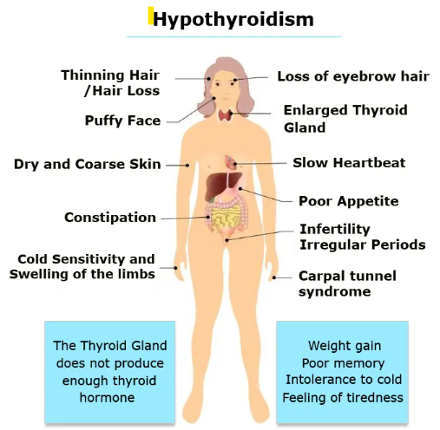
Deposits of chains of sugar molecules in the skin cause the skin condition myxedema. These compounds attract water, which leads to swelling. These skin changes are a result of hypothyroidism. Myxedema crisis often occurs after a long history of hypothyroidism.

Slide 23
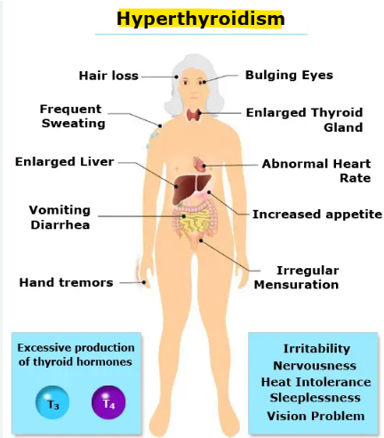

Slide 24
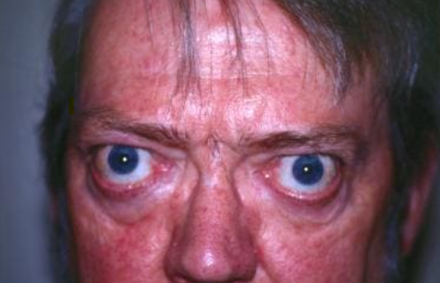
WATCHA LOOKING AT?

Slide 25
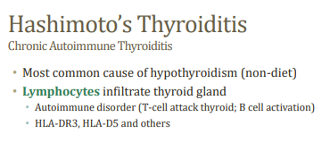
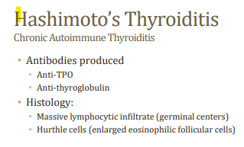
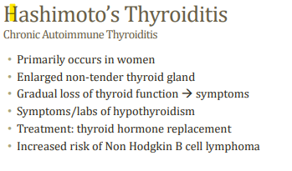

Slide 26
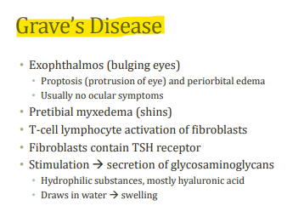
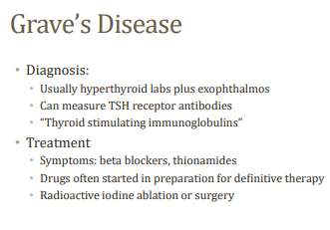

Slide 27
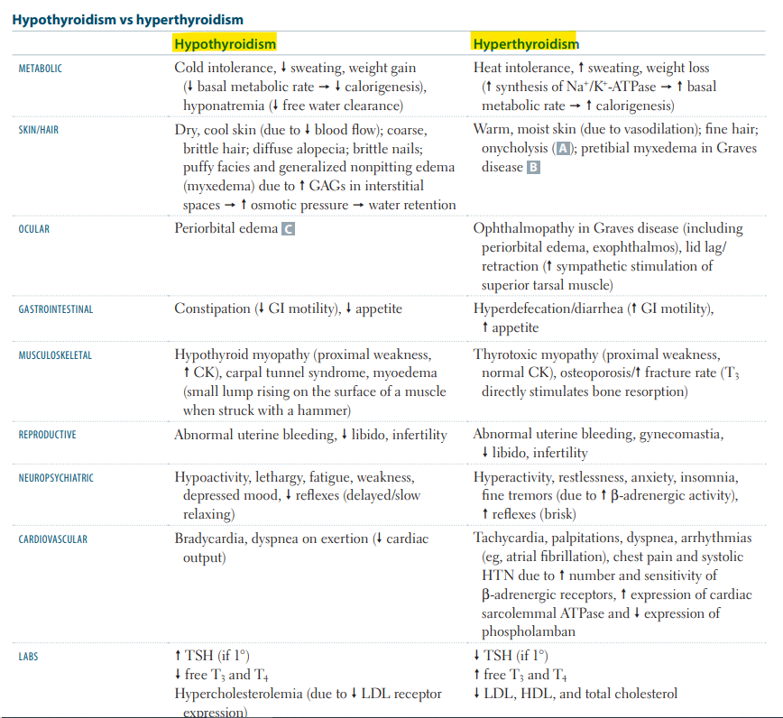

Slide 28
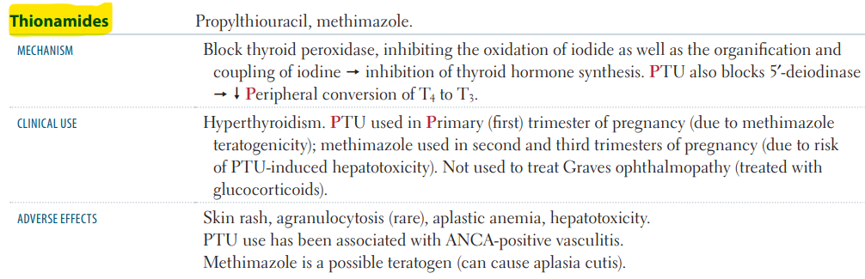

Slide 29
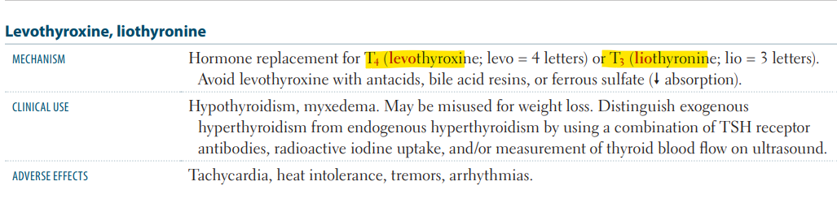

Slide 30
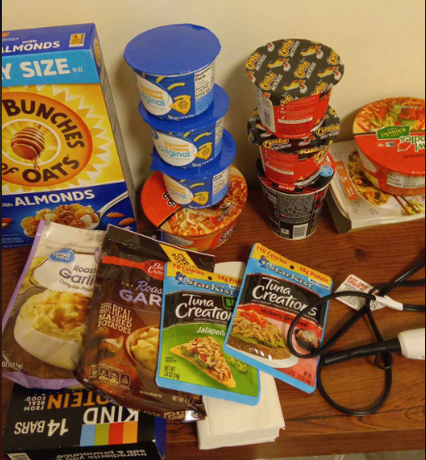

Slide 31
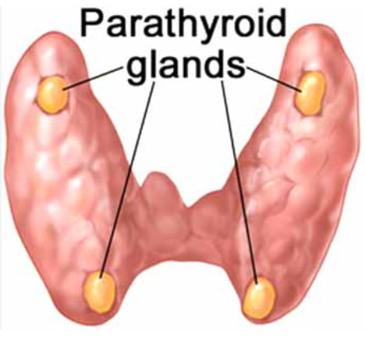

Slide 32
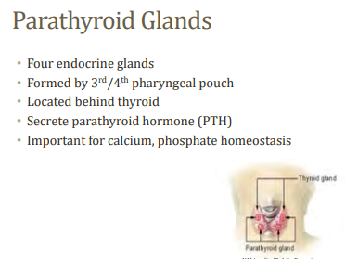
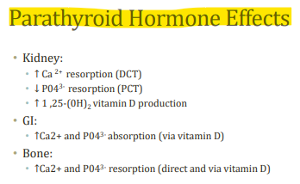
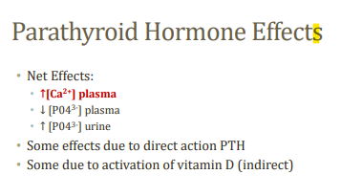

Slide 33
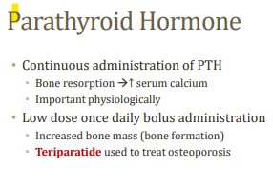
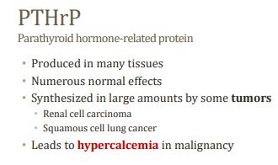
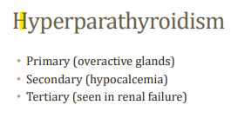
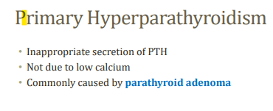

Slide 34



Slide 35



Slide 36



Slide 37


Slide 38
40 year old female is undergoing infertility treatments. Which of the following drugs might be included in her treatment regimen.
Cabergoline
Follitropin
Methimazole
Vasopressin
Which of the following is the treatment of choice for hypothyroidism.
Iodide
Levothyroxine
Liothyronine
Liotrix
Propylthiouracil

Slide 39
All of the following agents are correctly paired with an appropriate clinical use of the drug except:
Desmopressin- treatment of diabetes insipidus
hCG- treatment of infertility
Octreotide- treatment of esophageal varices
Oxytocin-Induction of labour
Gosrelin-Growth hormone deficiency
Human chorionic gonadotropin (hCG)
Goserelin is a type of hormone therapy called a luteinising hormone blocker causing growth hormone deficiency by decreasing testosterone/estrogen secretion.
are a hormone that can increase a person's chances of pregnancy, helps produce testosterone and sperm, and treats a condition that affects the testes called cryptorchidism.

Slide 40


